Slide 1
Problem
Dietary comorbidities and allergies are becoming common by the day. Many are supposed to take dietary caution but:
Product labels can be misleading and complex
Missing ingredient properties
Missing allergen information

Slide 2
Idea
People that have food allergies or intolerances scan through every product packaging to check the ingredients.
What if there was an app that does that for you?

Slide 3
Quancious
Team Lalalala
Neha Kothari
Shreyas Gupta
Ankita Paul
Tejas Kotha

Slide 4
Quancious
An AI based camera app that helps you do your grocery shopping without you needing to worry about the ingredients ever again.

Slide 5
Features
Scanning Food Labels:
Sugar synonyms
Allergens
Glycemic Index categories
User Profiles

Slide 6
Sugar Synonyms
Many brands tend to hide their sugar contents in their labels by using synonyms to mislead consumers into consuming their high sugar commodities.
Now find the amounts of various hidden sugars with Quancious.

Slide 7
Allergens
Common allergens like palm oil, peanuts, eggs, coconut, etc. could lead to serious implications if ignored.
Quancious warns you of such allergens present in your groceries with just a click.

Slide 8
Glycemic Index
Glycemic index is a value used to measure how much specific foods increase blood sugar levels.
With Quancious users will be notified of the GI category their food falls into.

Slide 9
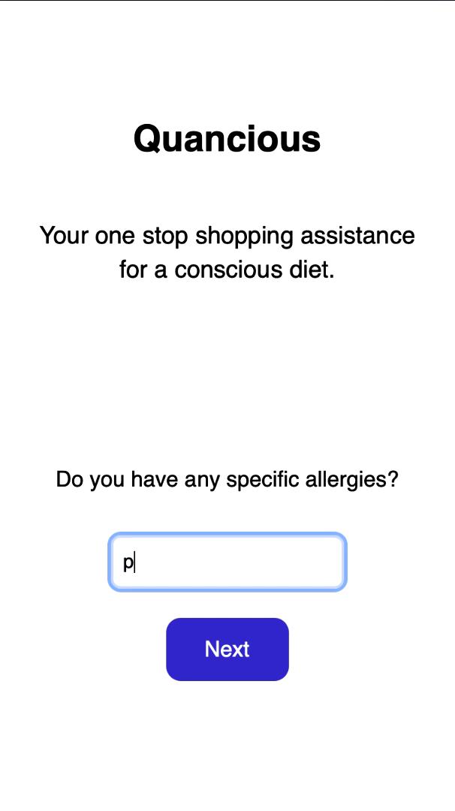
Demo

Slide 10
Thank You

